Slide 1
Data Science with Python
17/04/2024

Slide 2
Course Overview
The Data Science with Python course provides a comprehensive overview of Python's tools and techniques for data analytics. Learning Python is a vital skill for numerous data science roles, and you can cultivate it through this course.

Slide 3
Benefits of Enrolling in a Course:
Gain an in-depth understanding of Data Science processes, data wrangling, data exploration, data visualization, hypothesis building, and testing. You will also learn the basics of statistics.
Install the required Python environment and other auxiliary tools and libraries.
Understand the essential concepts of Python programming such as data types, tuples, lists, dicts, basic operators and functions.
Perform high-level mathematical computing using the NumPy, Panda’s package and its vast library of mathematical functions.
Perform scientific and technical computing using the SciPy package and its sub-packages such as Integrate, Optimize, Statistics, IO, and Weave.
Perform data analysis and manipulation using data structures and tools provided in the Pandas package.
Gain expertise in Machine Learning using the Scikit-Learn package.

Slide 4
Topics
Python Basics
Python Data Structures.
Working with Data in Python
Data Science with Python
Mathematical Computing with Python (NumPy)
Scientific computing with Python (SciPy)

Slide 5
Module I Python Basics

Slide 6
Conditions and Loops
Module I Python Basics

Slide 7
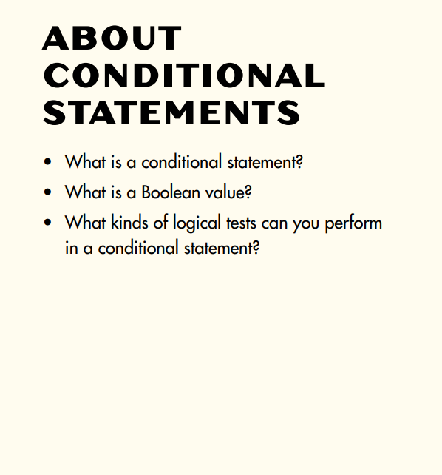

Slide 8
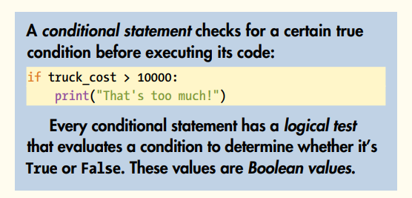

Slide 9
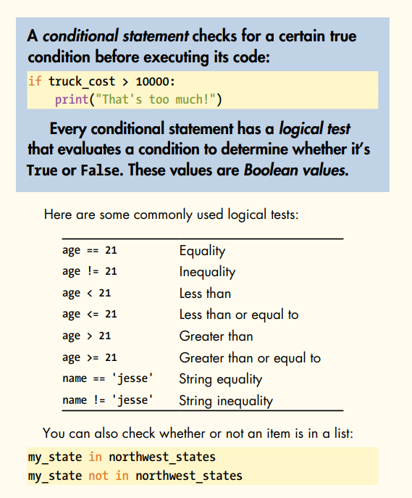

Slide 10
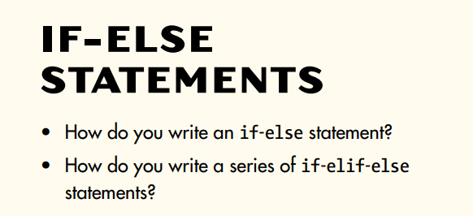

Slide 11
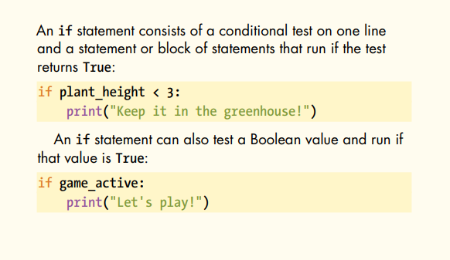

Slide 12
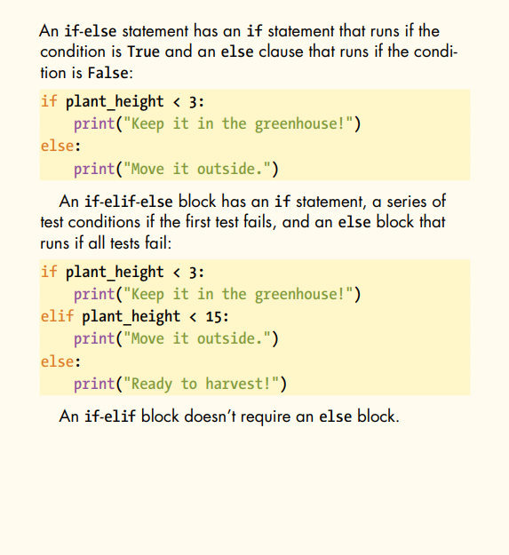

Slide 13
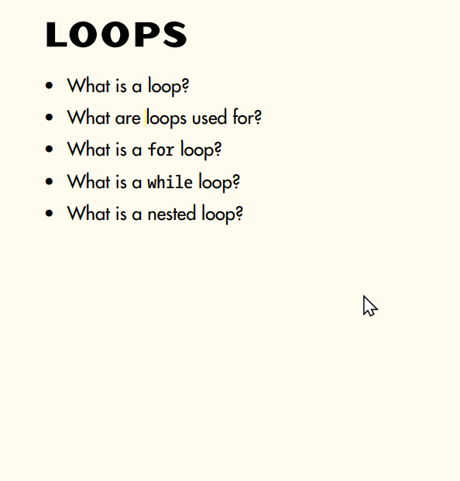

Slide 14
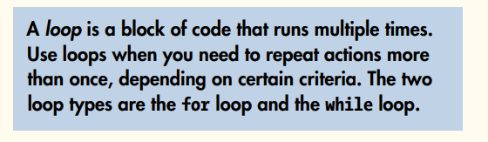

Slide 15
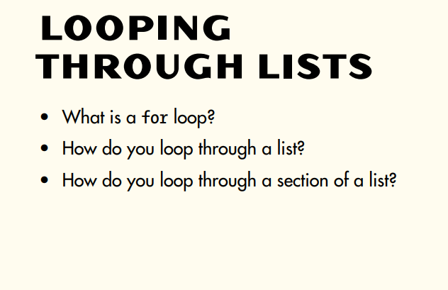

Slide 16
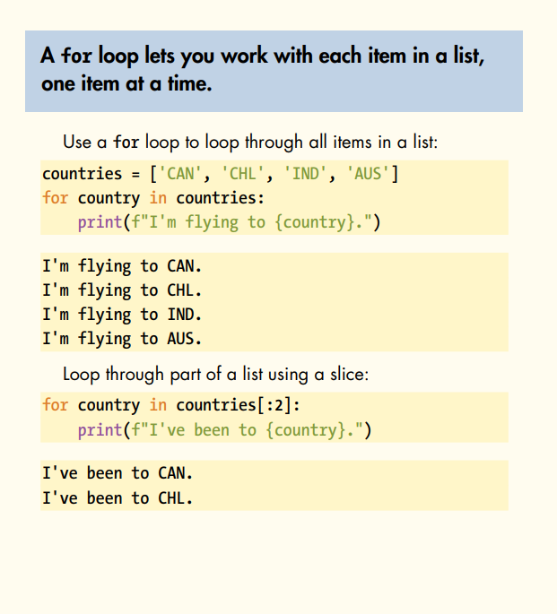

Slide 17
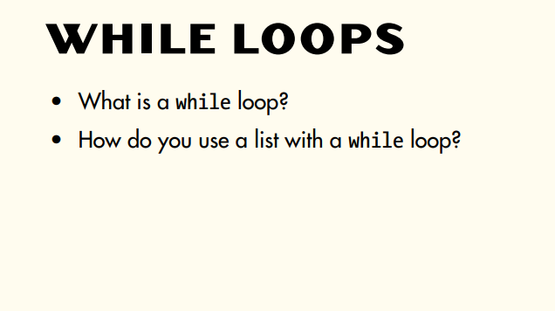
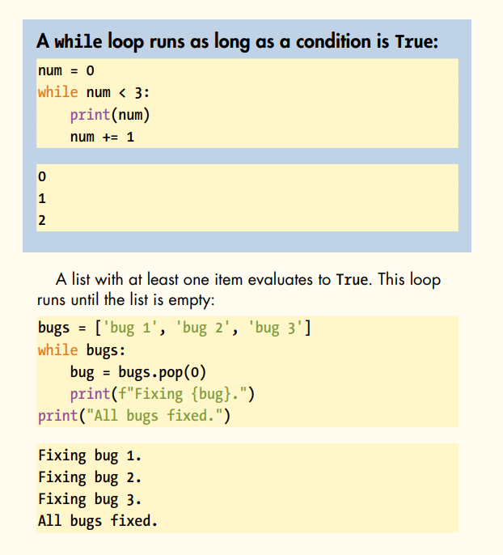

Slide 18
Python Functions
Module I Python Basics

Slide 19
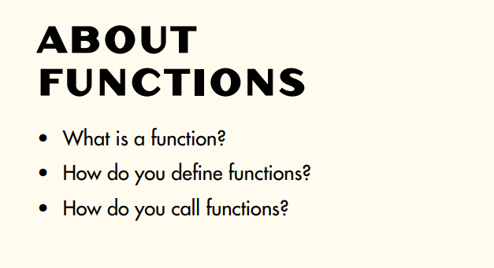

Slide 20
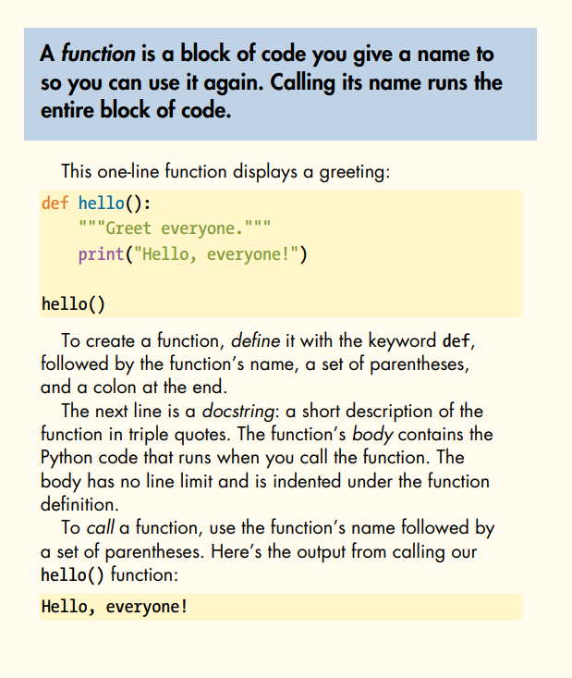

Slide 21
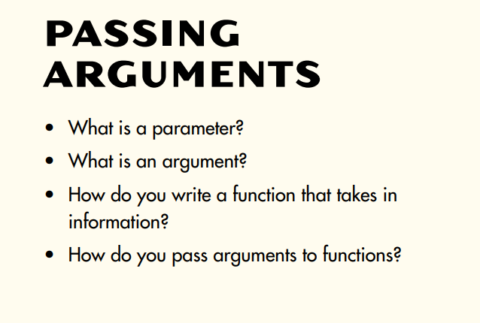

Slide 22
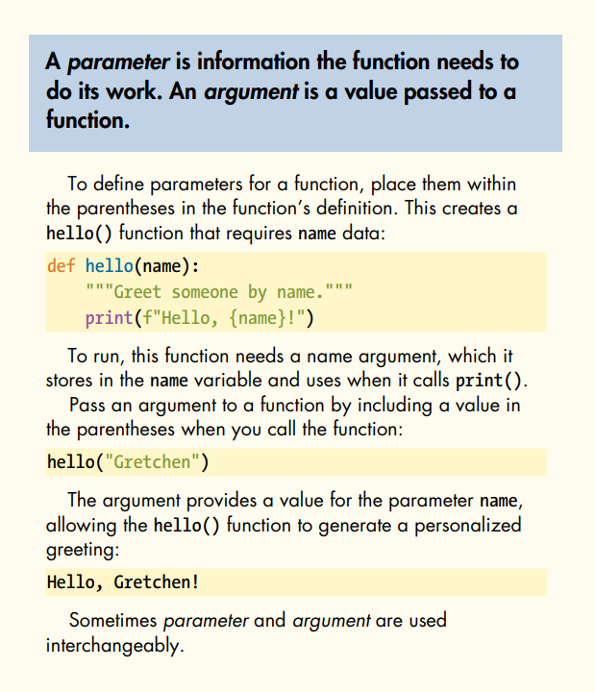

Slide 23
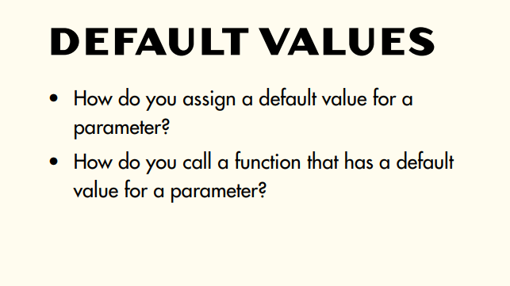

Slide 24
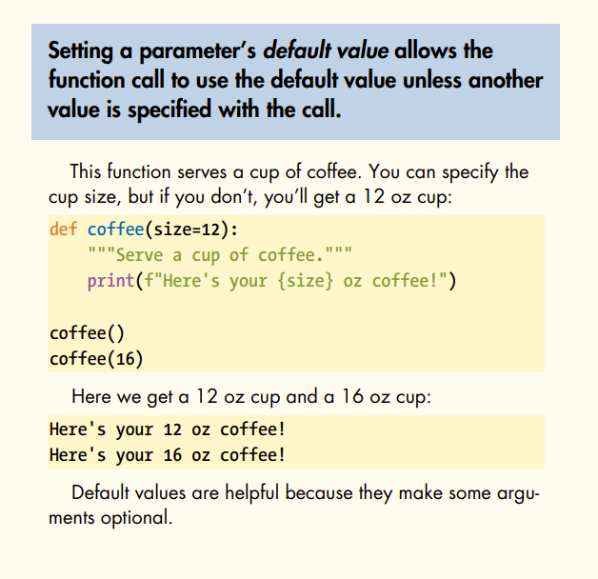

Slide 25
Python Recursion
Module I Python Basics

Slide 26
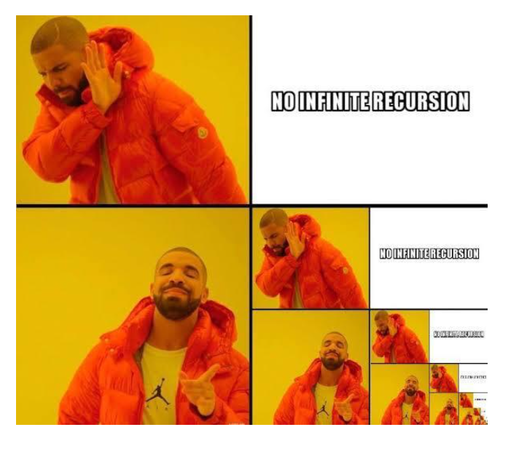

Slide 27
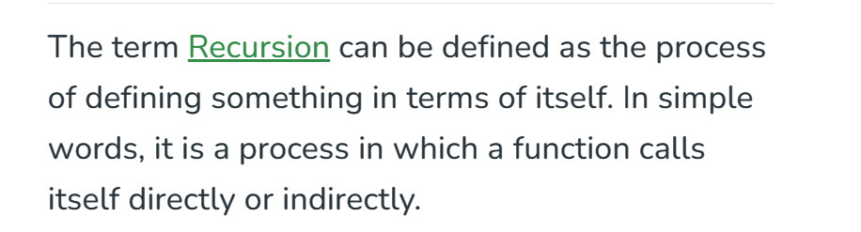
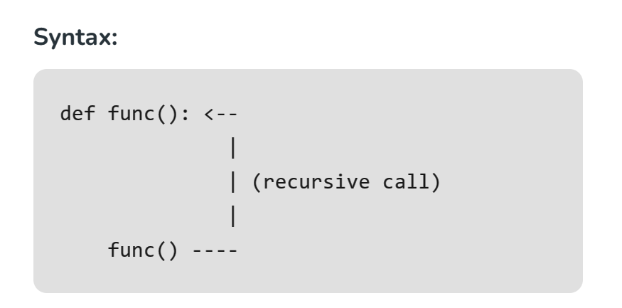

Slide 28
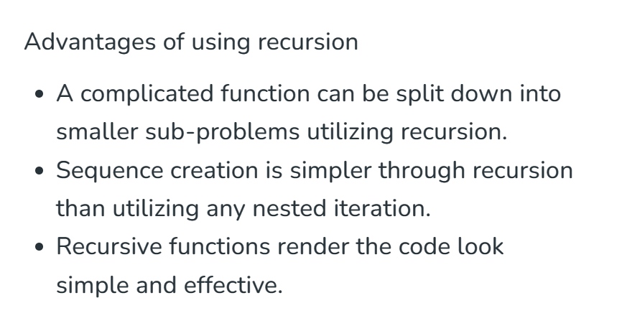

Slide 29
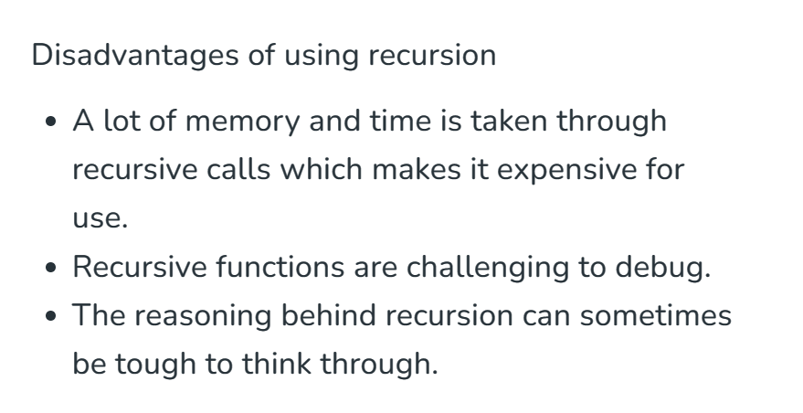

Slide 30
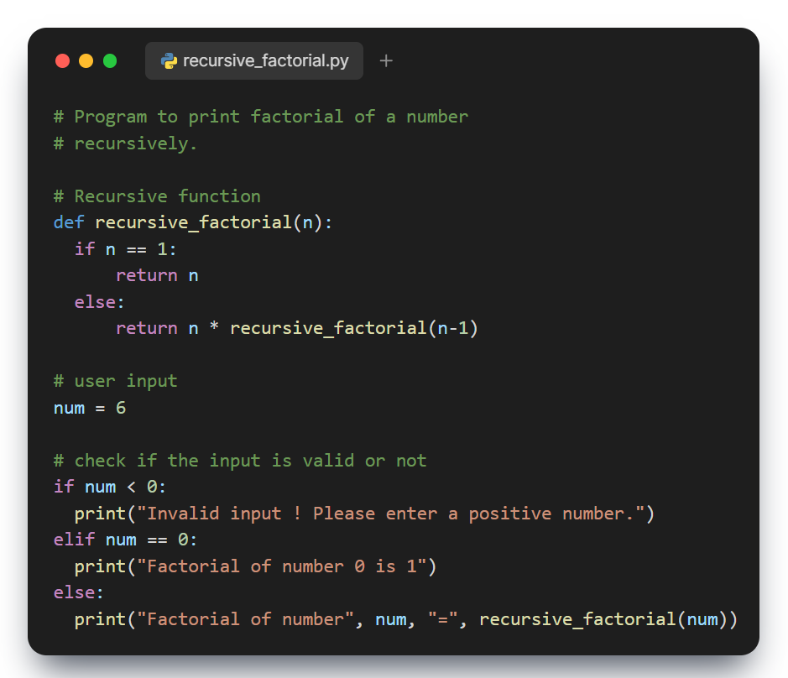
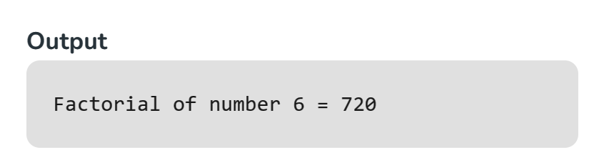

Slide 31
Python Classes
Module I Python Basics

Slide 32
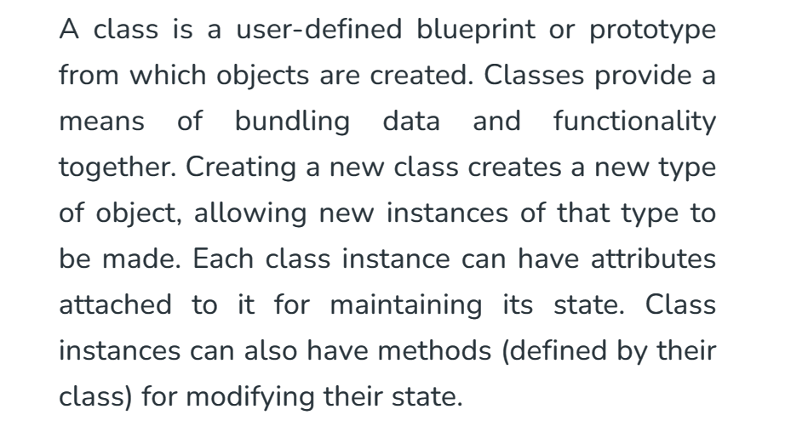

Slide 33
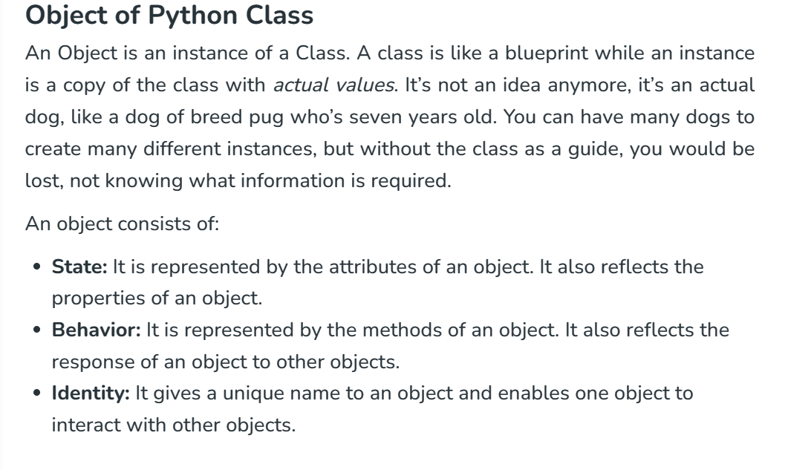

Slide 34
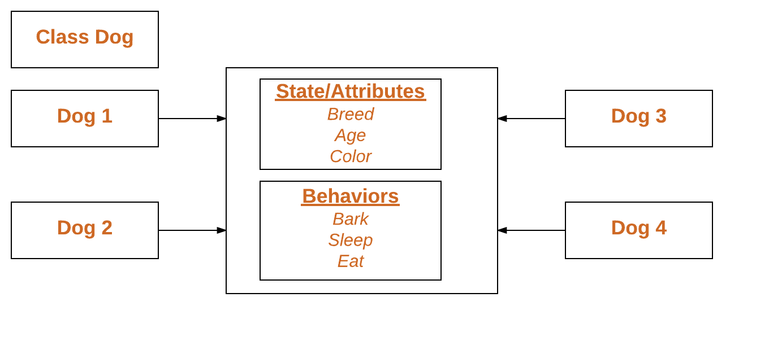

Slide 35
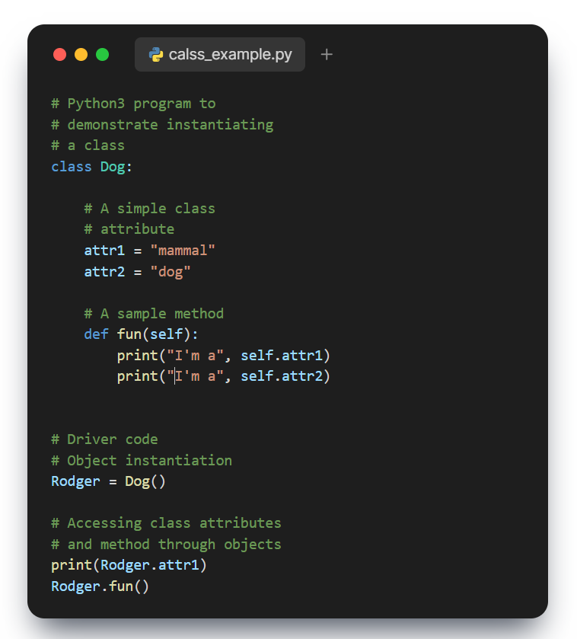
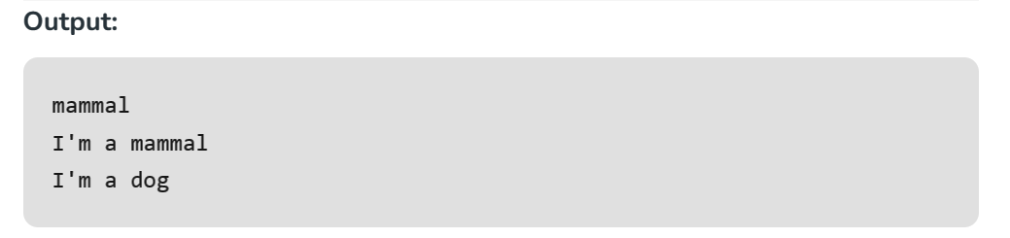

Slide 36
Q&A
Questions and answers

Slide 37
Module II Python Data Structures

Slide 38
Big O notation
Module II Python Data Structures

Slide 39


Slide 40
Big O Notation ?
Big-O notation describes how long it takes for an algorithm to get desired output depending on the given input as the input get arbitrarily large.
Let’s examine some of these points more closely:
Remember, we want to compare how quickly runtime will grows, not compare exact runtime, since those can vary depending on hardware.
Since we want to compare for a variety of input sizes, we are only concerned with runtime grow relative to the input. This is why we use n for notation.
As n gets arbitrarily large we only worry about terms that will grow the fastest as n gets large, to this point, Big-O analysis is also known as asymptotic analysis

Slide 41
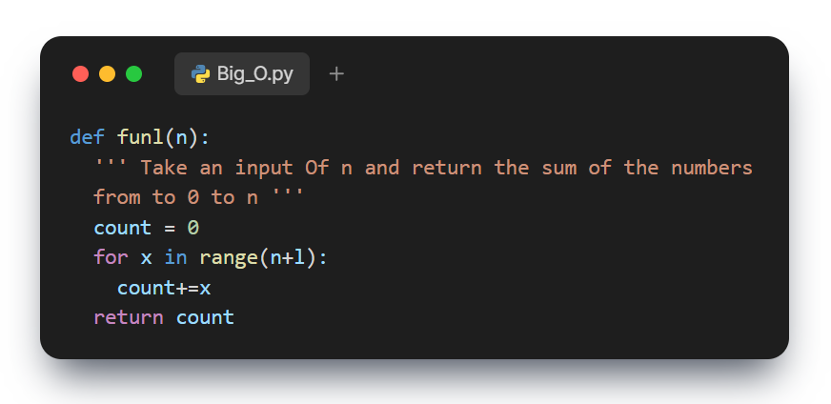
As for syntax fun1() can be said to be O(n)
since its runtime grows linearly with the input size.

Slide 42
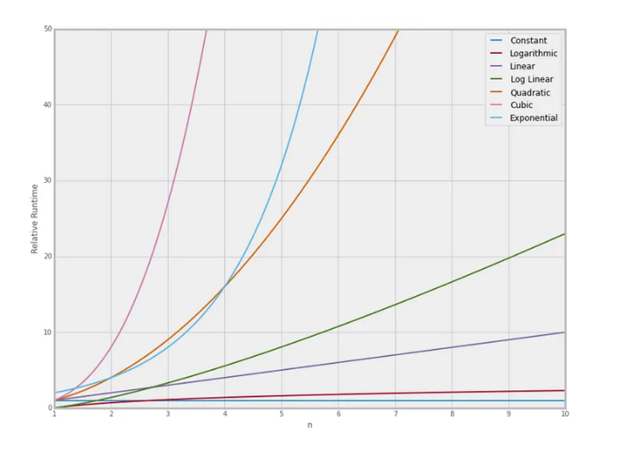
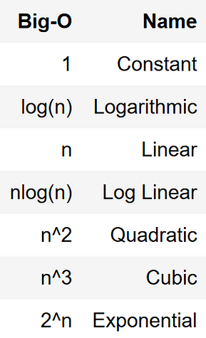
Smaller values ranges from 1 to 2 the runtime does not make any difference as we get more larger values the runtime may varies as shown in above plot.

Slide 43
Stacks, queues and deques
Module II Python Data Structures

Slide 44
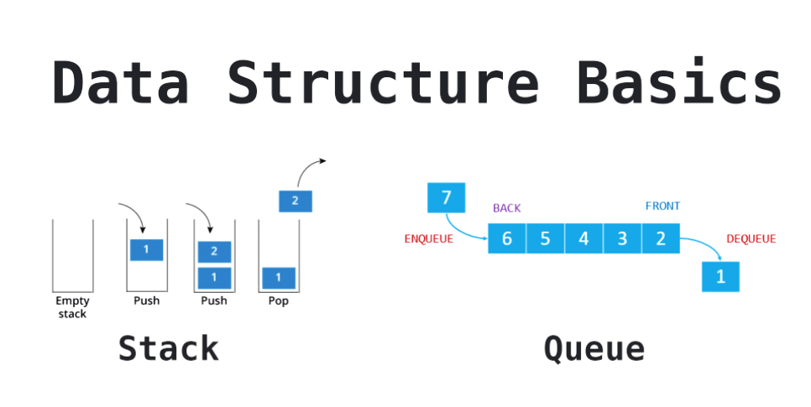

Slide 45
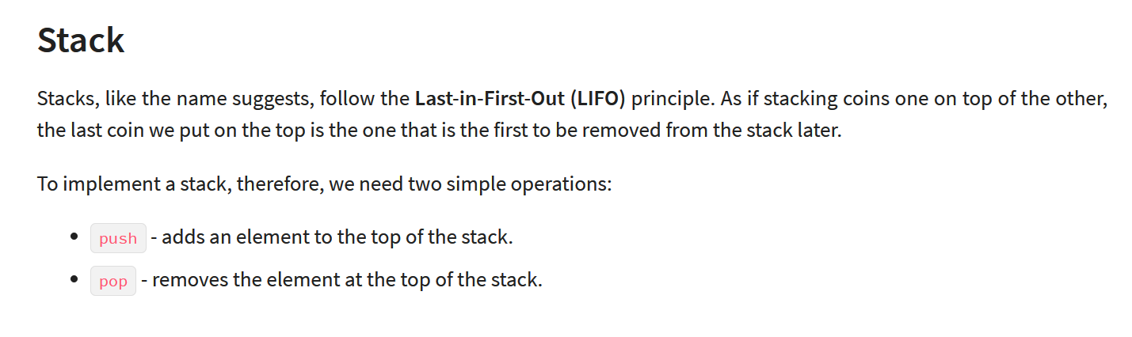

Slide 46
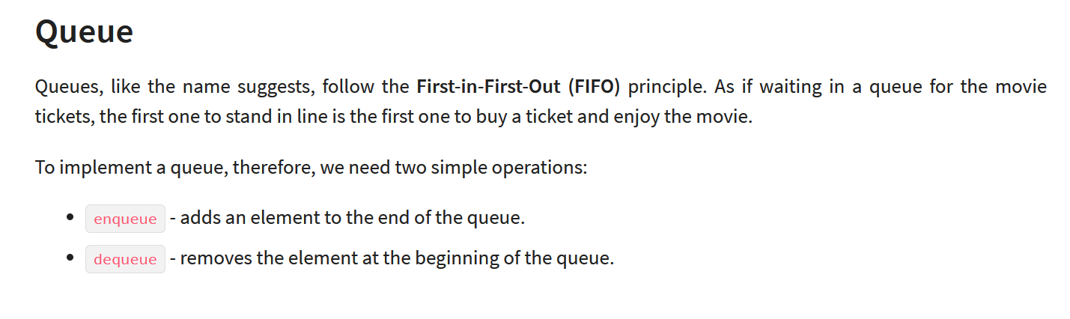

Slide 47
Stacks and Queues using Lists
Python’s built-in List data structure comes bundled
with methods to simulate both stack and queue operations.

Slide 48
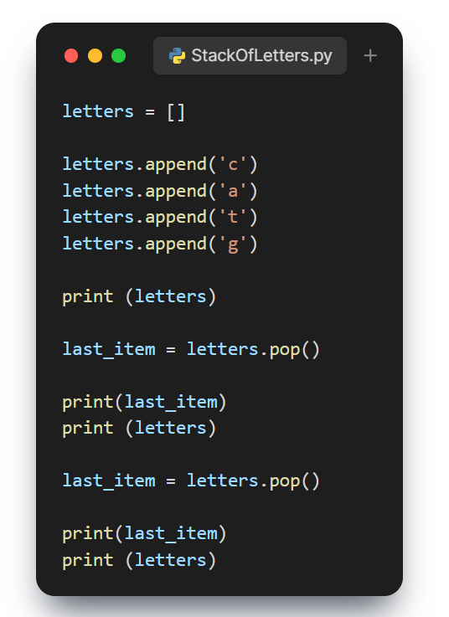
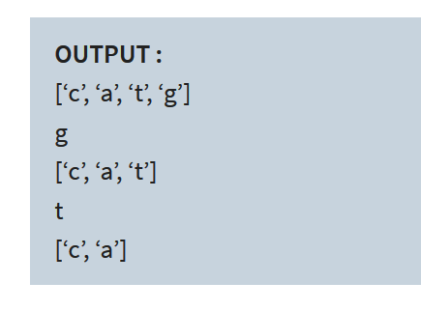

Slide 49
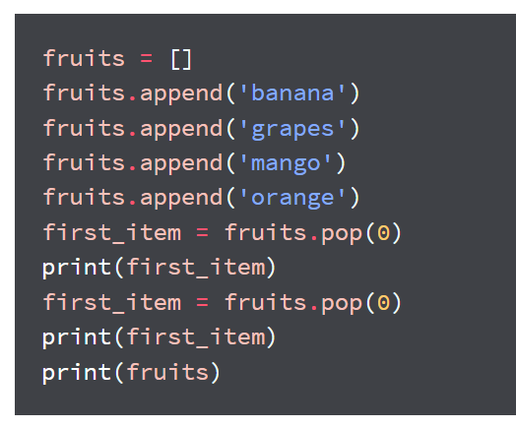
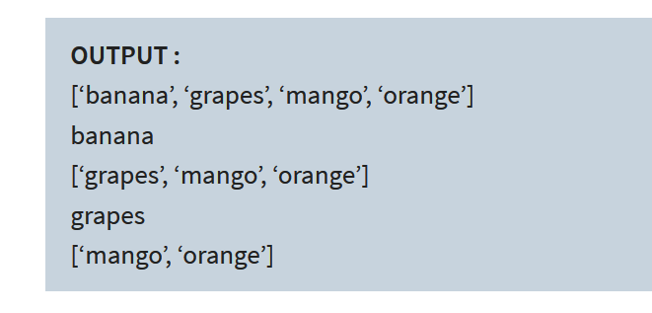

Slide 50
Stacks and Queues with the Deque Library
Python has a deque (pronounced ‘deck’) library
that provides a sequence with efficient methods to
work as a stack or a queue.
deque is short for Double Ended Queue - a generalized
queue that can get the first or last element that’s stored

Slide 51
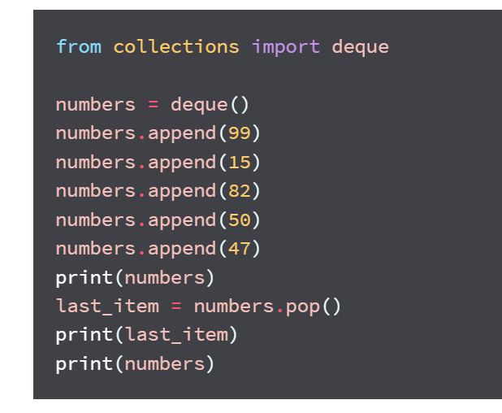
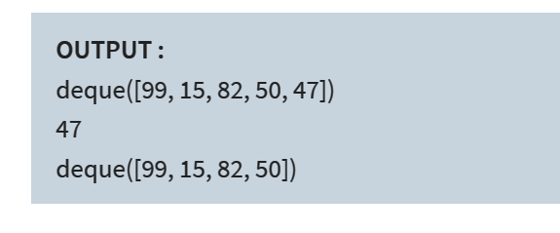

Slide 52
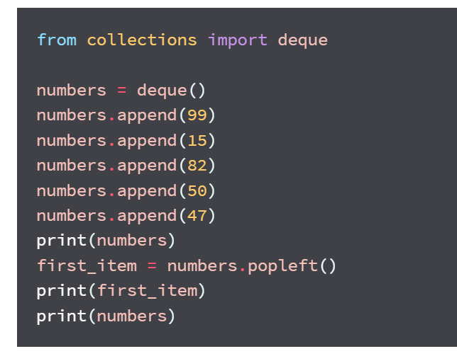
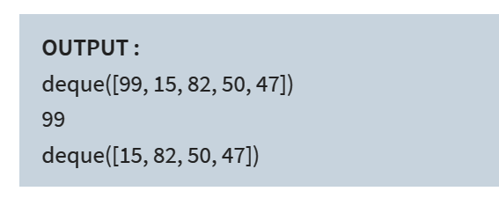

Slide 53
Variables, Lists, Tuple, Set, dictionaries
Module II Python Data Structures

Slide 54
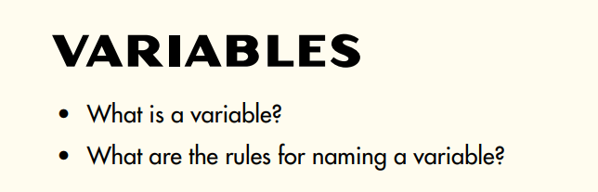
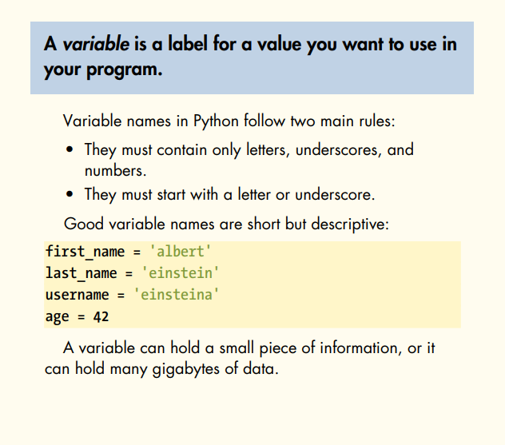

Slide 55
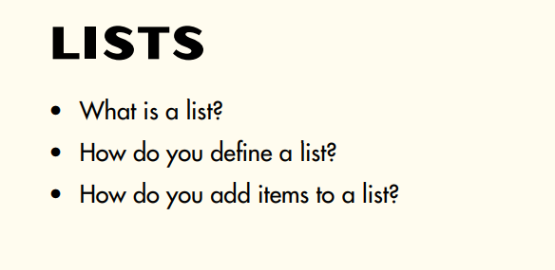

Slide 56
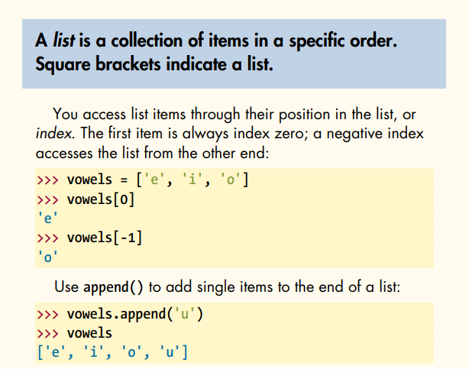
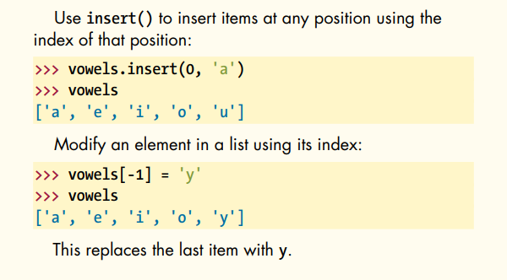

Slide 57
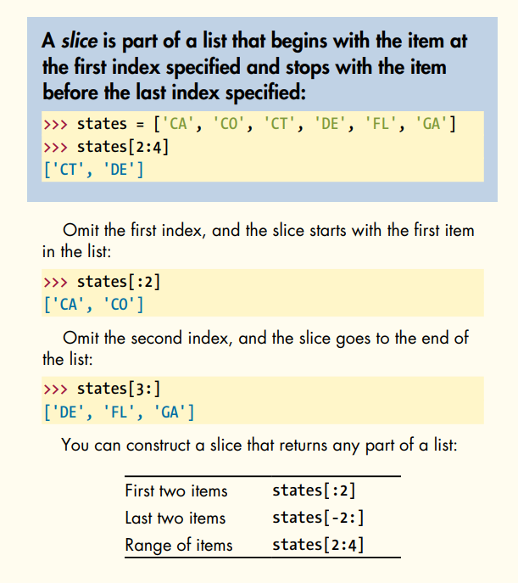


Slide 58



Slide 59


Slide 60


Slide 61



Slide 62


Slide 63



Slide 64


Slide 65



Slide 66
Q&A
Questions and answers

Slide 67
Module III Working with Data in Python

Slide 68
Read and Write data to files
Module III Working with Data in Python

Slide 69




Slide 70

File Access Modes

Slide 71



Slide 72


Slide 73



Slide 74
Data pickling
Module III Working with Data in Python

Slide 75


Slide 76

Python Pickle — Python object serialization

Slide 77



Slide 78

Advantages of Using Pickle in Python

Slide 79

Disadvantages of Using Pickle in Python

Slide 80
Module IIII Mathematical Computing with Python (NumPy)

Slide 81
Intro
Module IIII Mathematical Computing with Python (NumPy)

Slide 82


Slide 83


Slide 84


Slide 85


Slide 86


Slide 87


Slide 88


Slide 89


Slide 90


Slide 91
Vectors and arrays
Module IIII Mathematical Computing with Python (NumPy)

Slide 92


Slide 93



Slide 94


Slide 95


Slide 96


Slide 97


Slide 98


Slide 99


Slide 100


Slide 101


Slide 102


Slide 103


Slide 104


Slide 105


Slide 106


Slide 107
Scientific computing with Python (Scipy)
Module IIII Mathematical Computing with Python (NumPy)

Slide 108


Slide 109


Slide 110



Slide 111
Q&A
Questions and answers

Slide 112
Thanks

